Slide 1

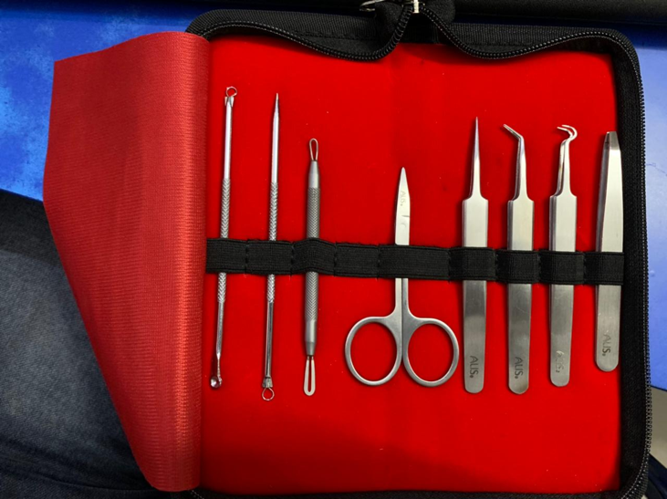
Blackhead and Pimple care Kit
1 | Blackhead remover loop and scoops
2 | Pimple popping and remove dead blackhead
3 | Blackhead and white head remover
4 | Eyebrow cutting /eyelashes cutting /Nails cutting scissors.
5 | Pimple popping.
6 | Small blackheads and white heads easy removal.
7 | Blackhead and whitehead pull up.
8 | Hair remover for upper lip/Eyebrow hair/ Ignoring hair.
Hsn: 9018

Slide 2
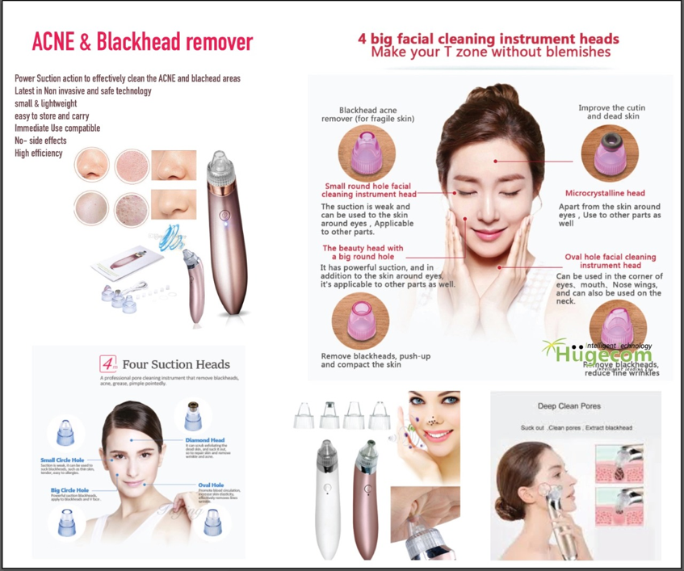

RS. 250/- BATTERY
RS 500/- RECHARGEABLE
Acne & Blackhead Remover
Hsn: 90291090

Slide 3
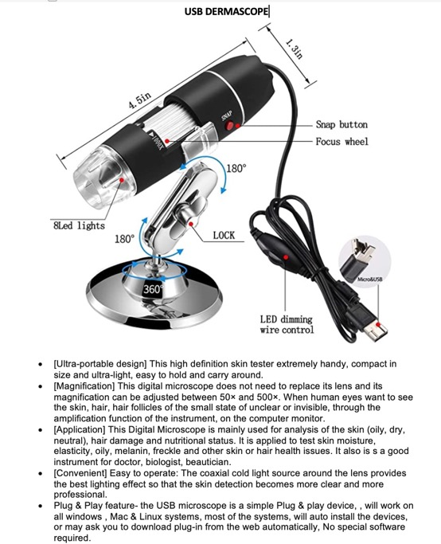

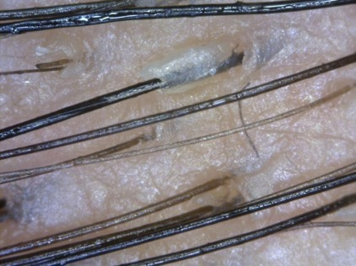
RS. 895/-
Hsn: 90291090
Digital Microscope – PC & Mobile interface

Slide 4
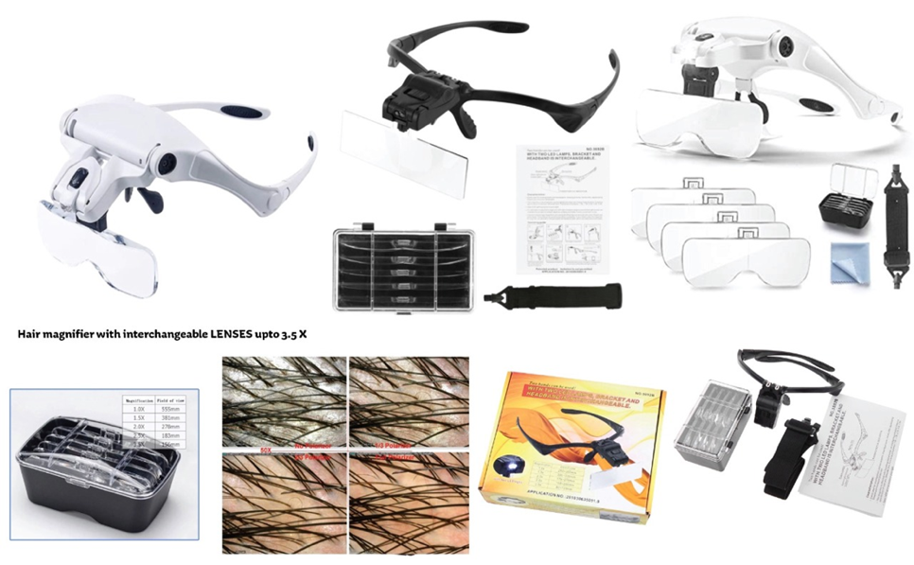

Hsn: 90291090
Hair magnifier with Interchangeable lenses upto 3-5X

Slide 5
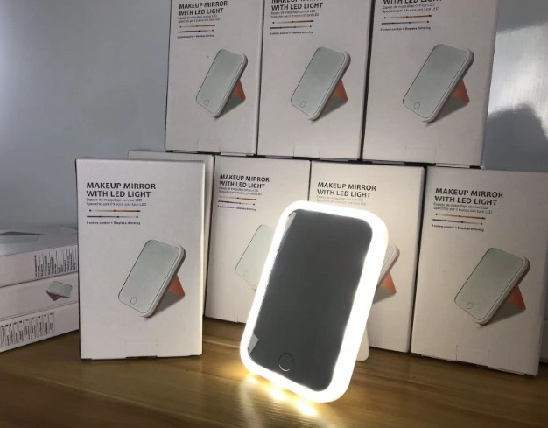
LED Mirror
2 colour light
Rechargeable
Desktop model
Portable

Slide 6

Aloe vera gloves Disposable gloves

Slide 7
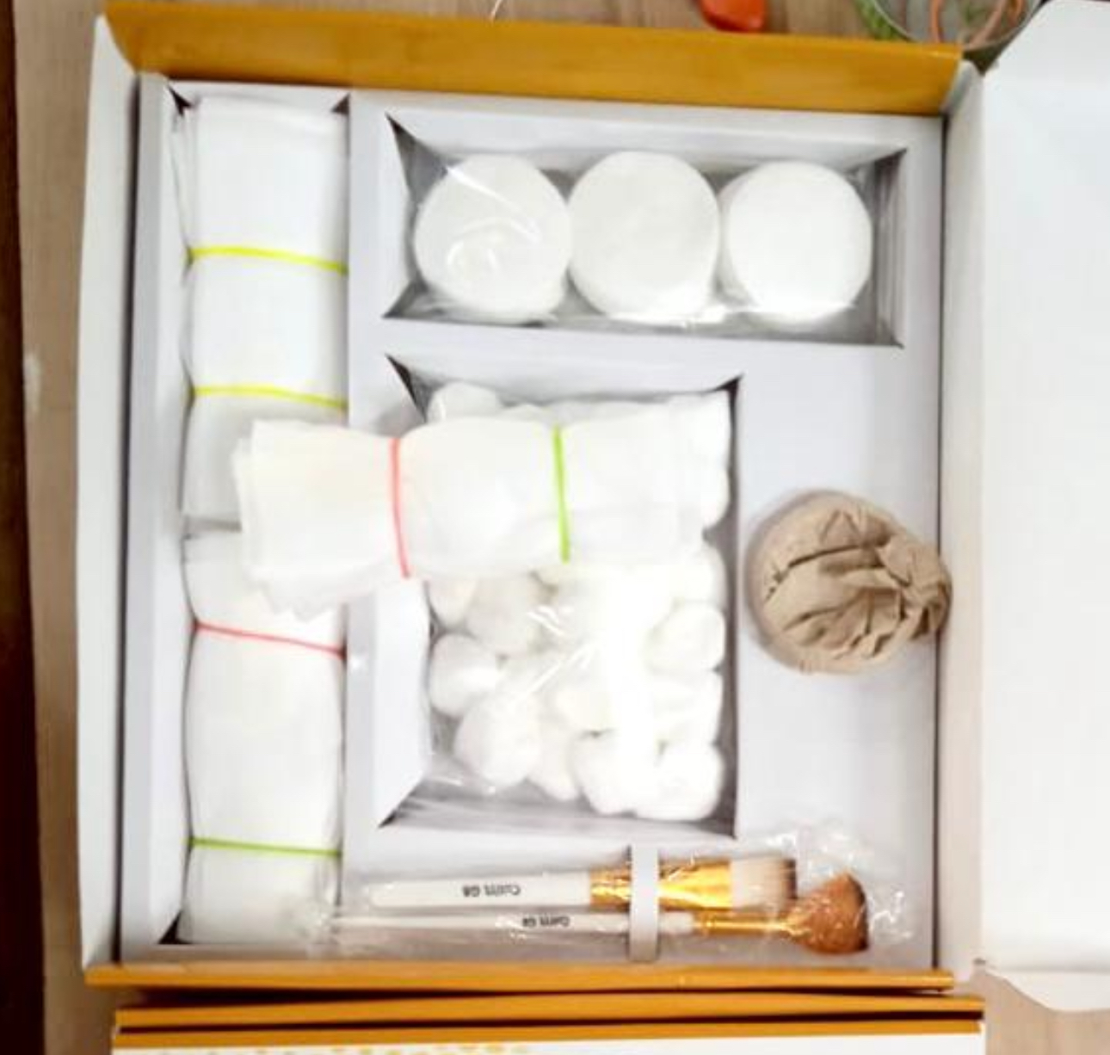
Derma Kit
Cotton balls
Cotton Swabs
Headbands
Peel brushes

Slide 8
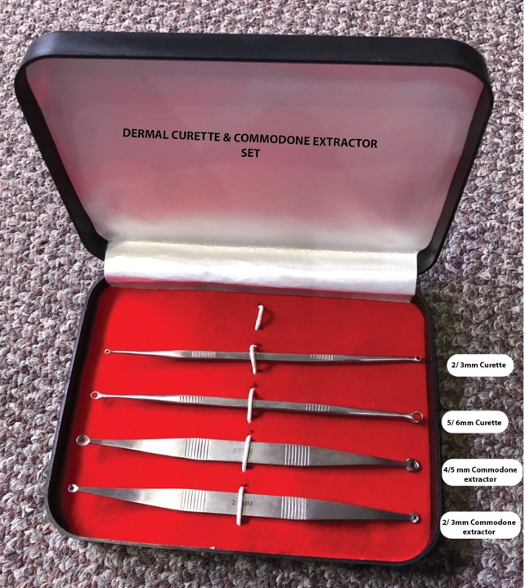
Curette & Commodone extractor kit
RS. 350/-
Hsn: 9018

Slide 9
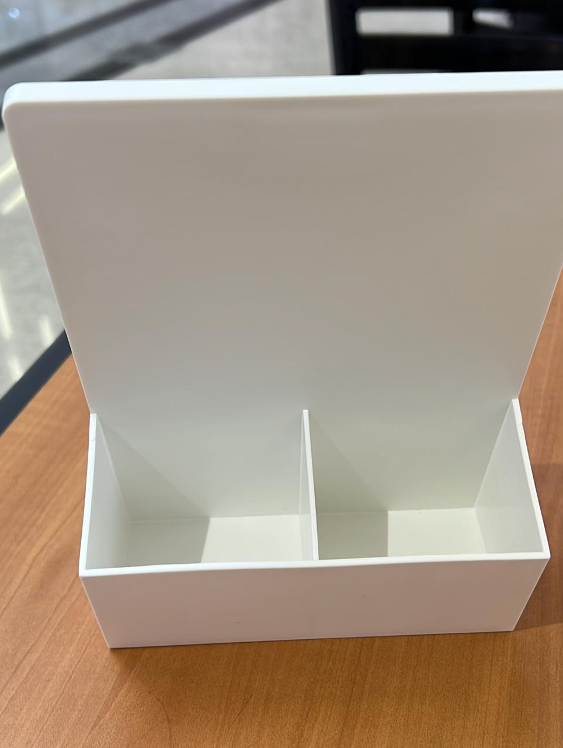
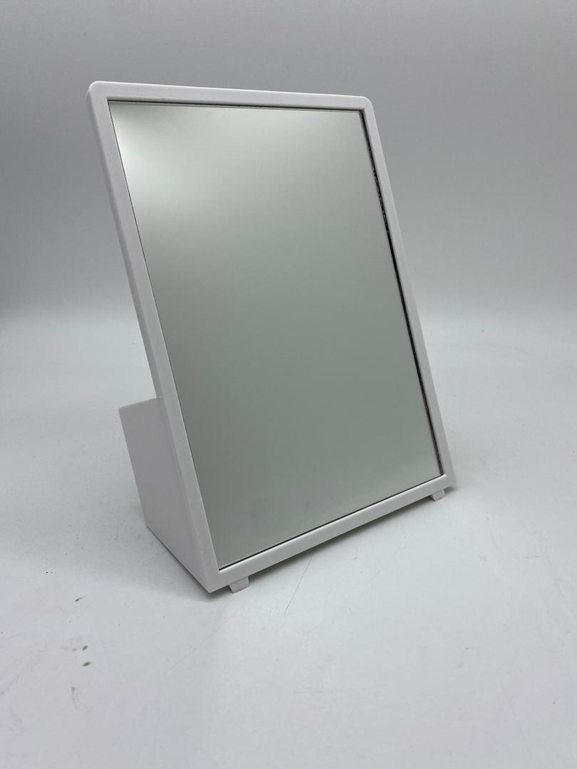
Mirror with Back compartments
Mirror with Storage

Slide 10


Slide 11

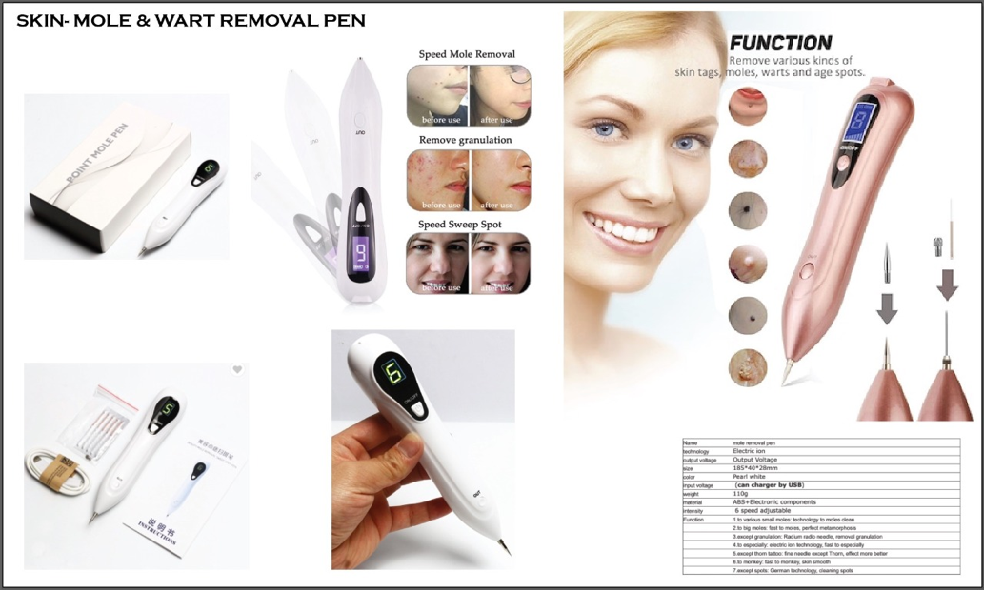
RS. 550/-
Skin Mole & wart removal pen
Hsn: 90291090

Slide 12

Bio needle
Adjustable Needle length
With vial for liquid

Slide 13

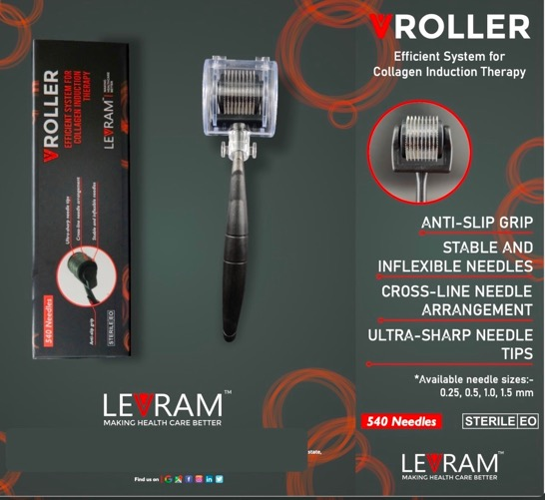
RS. 250/-
Hsn: 9018
Derma Roller –

Slide 14
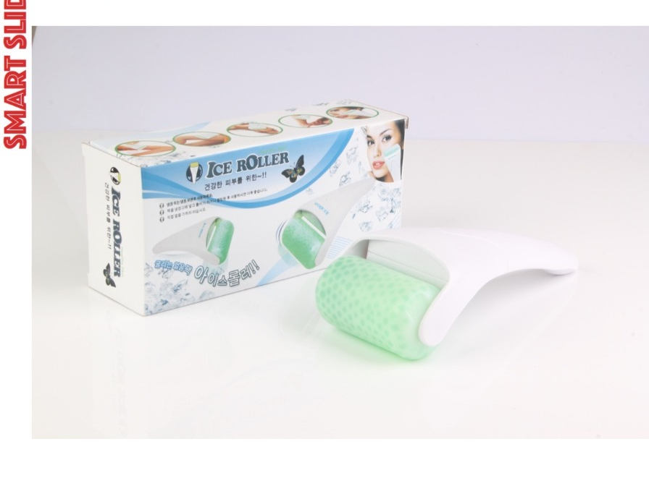

RS. 295/-
Ice Roller
Hsn: 9018

Slide 15
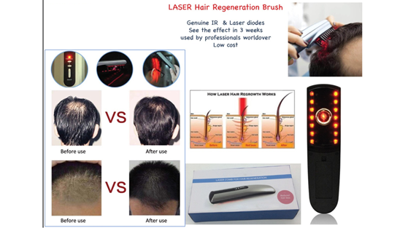

RS. 795/-
Laser Hair Regeneration Brush
Hsn: 90291090

Slide 16


6 in 1 Ice Derma Roller system
RS. 525/-
Hsn: 9018

Slide 17

RS. 895/-
Skin Analyser 3 in 1
Hsn: 90291090

Slide 18
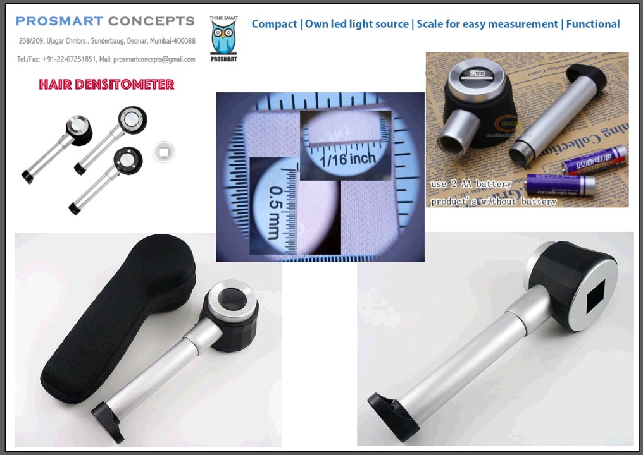
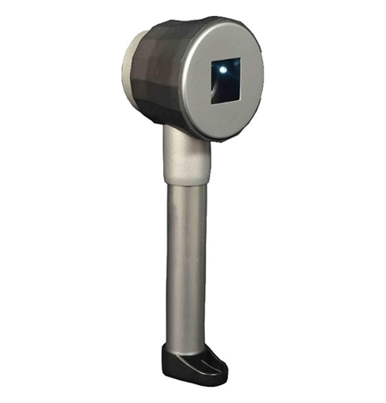
RS. 500/-
Hair Densitometer
Hsn: 90291090

Slide 19
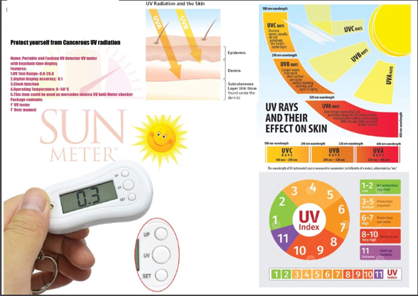
RS. 495/-
Sun Meter

Slide 20
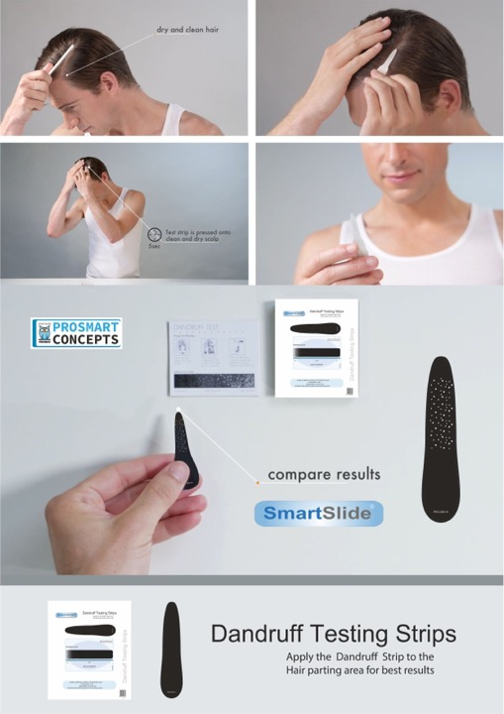
Dandruff Testing strips
RS. 6/-

Slide 21
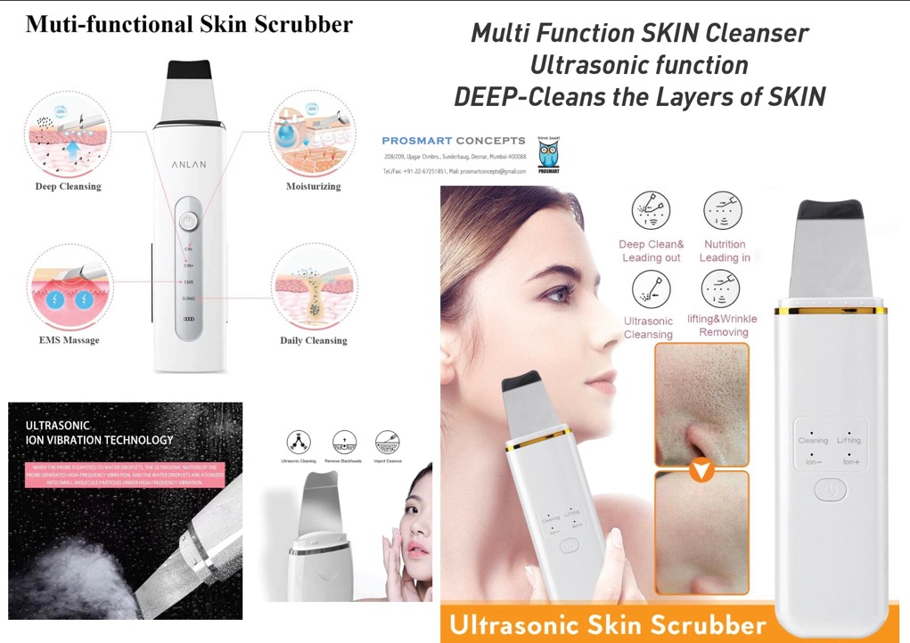
RS. 450/-
Hsn: 90291090

Slide 22

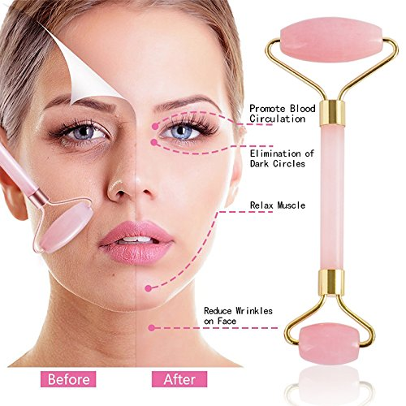
RS. 395/-
Facial Jade Roller
Hsn: 9018

Slide 23
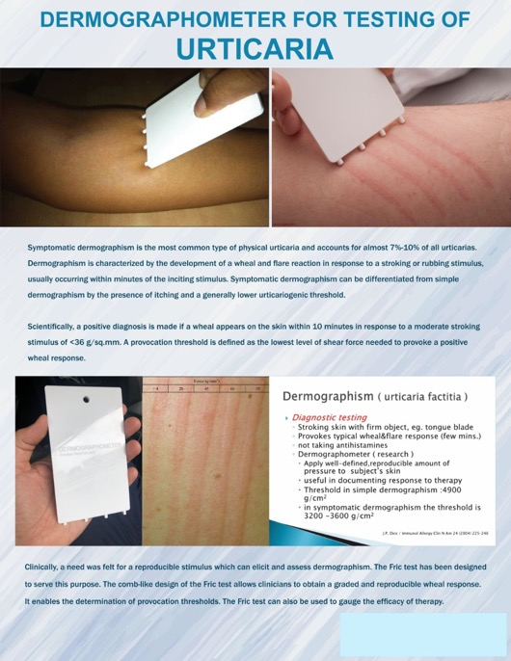

RS. 295/-
Hsn: 9018
Dermographometer for testing of Urticaria

Slide 24
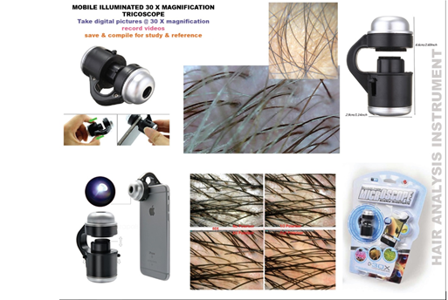

RS.310/-
Hsn: 90291090
Mobile Illuminated 30x magnification Tricoscope

Slide 25
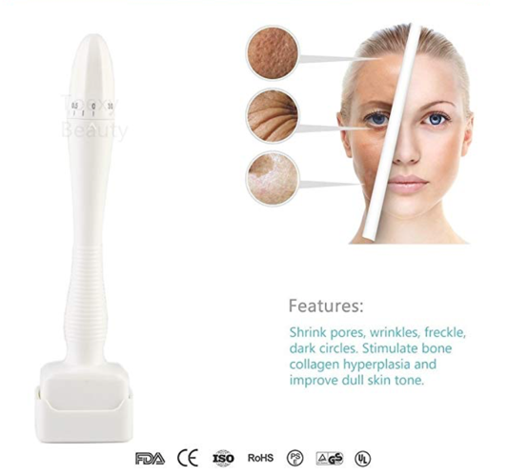
DERMA STAMP
RS. 595/-
Localised
Adjustable Length
microneedling
Hsn: 9018

Slide 26
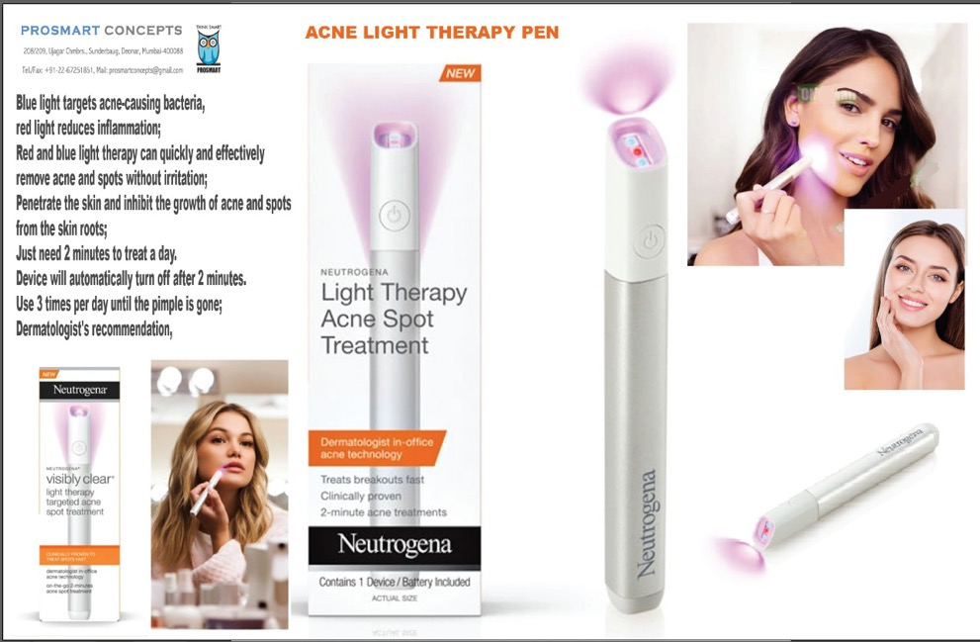
RS. 495/-
Hsn: 90291090

Slide 27
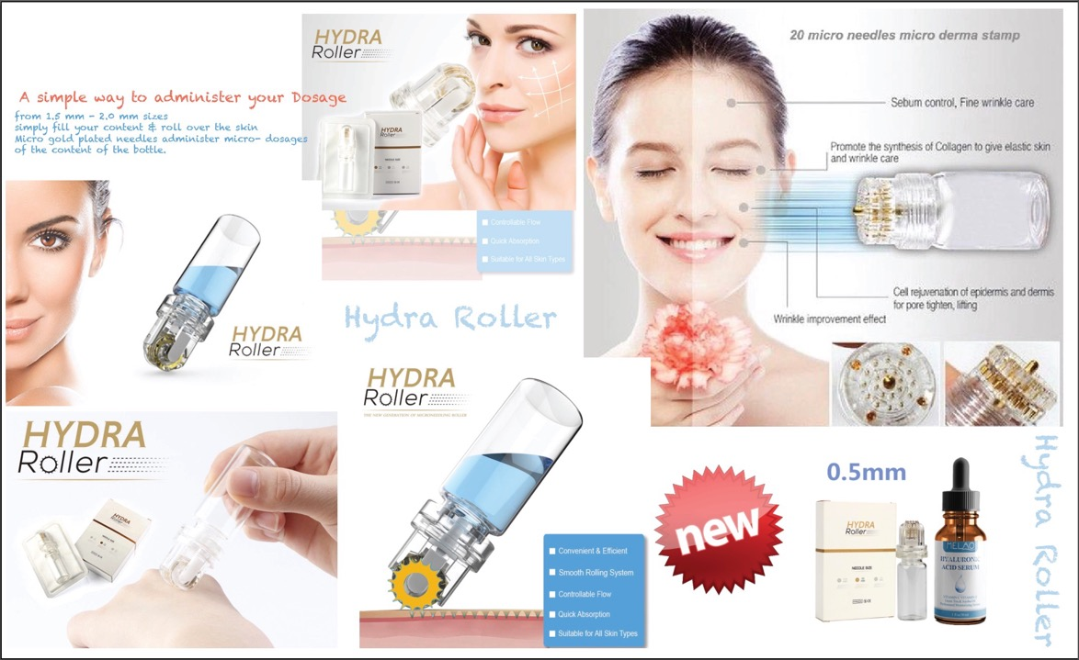
RS. 260/-
Hsn: 9018

Slide 28

PRP KIT
Rs 550/-
Hsn: 9018
Platelet Rich plasma injection therapy

Slide 29
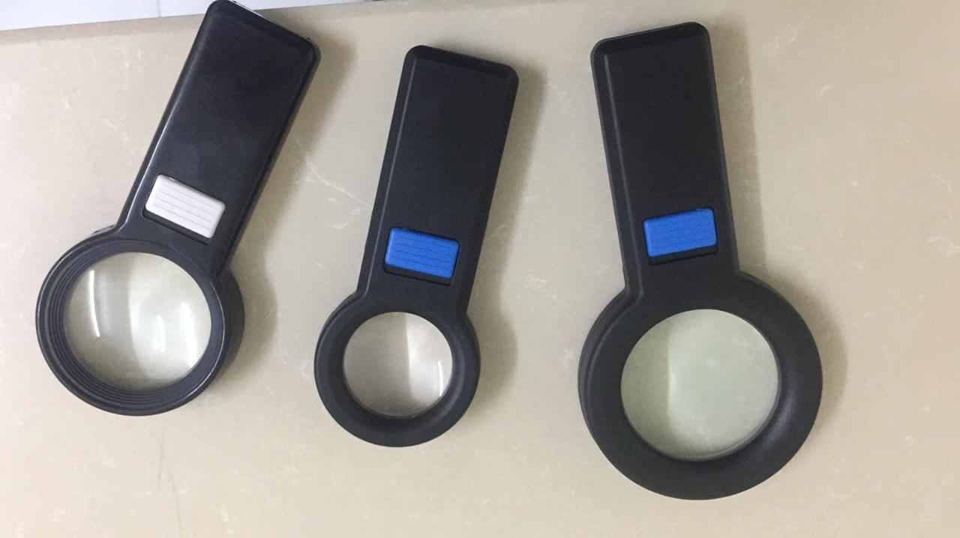
Different sizes of LED magnifiers
RS. 250/-
Hsn: 90291090

Slide 30
